Slide 1
NUMERICAL ANALYSIS OF FLUID FLOW IN ROTATING MICRO-CHANNELS
JAGANNATH SURESH - 111117041
JOHN S GEORGE - 111117046
SAMEER A DAMBAL - 111117076

Slide 2
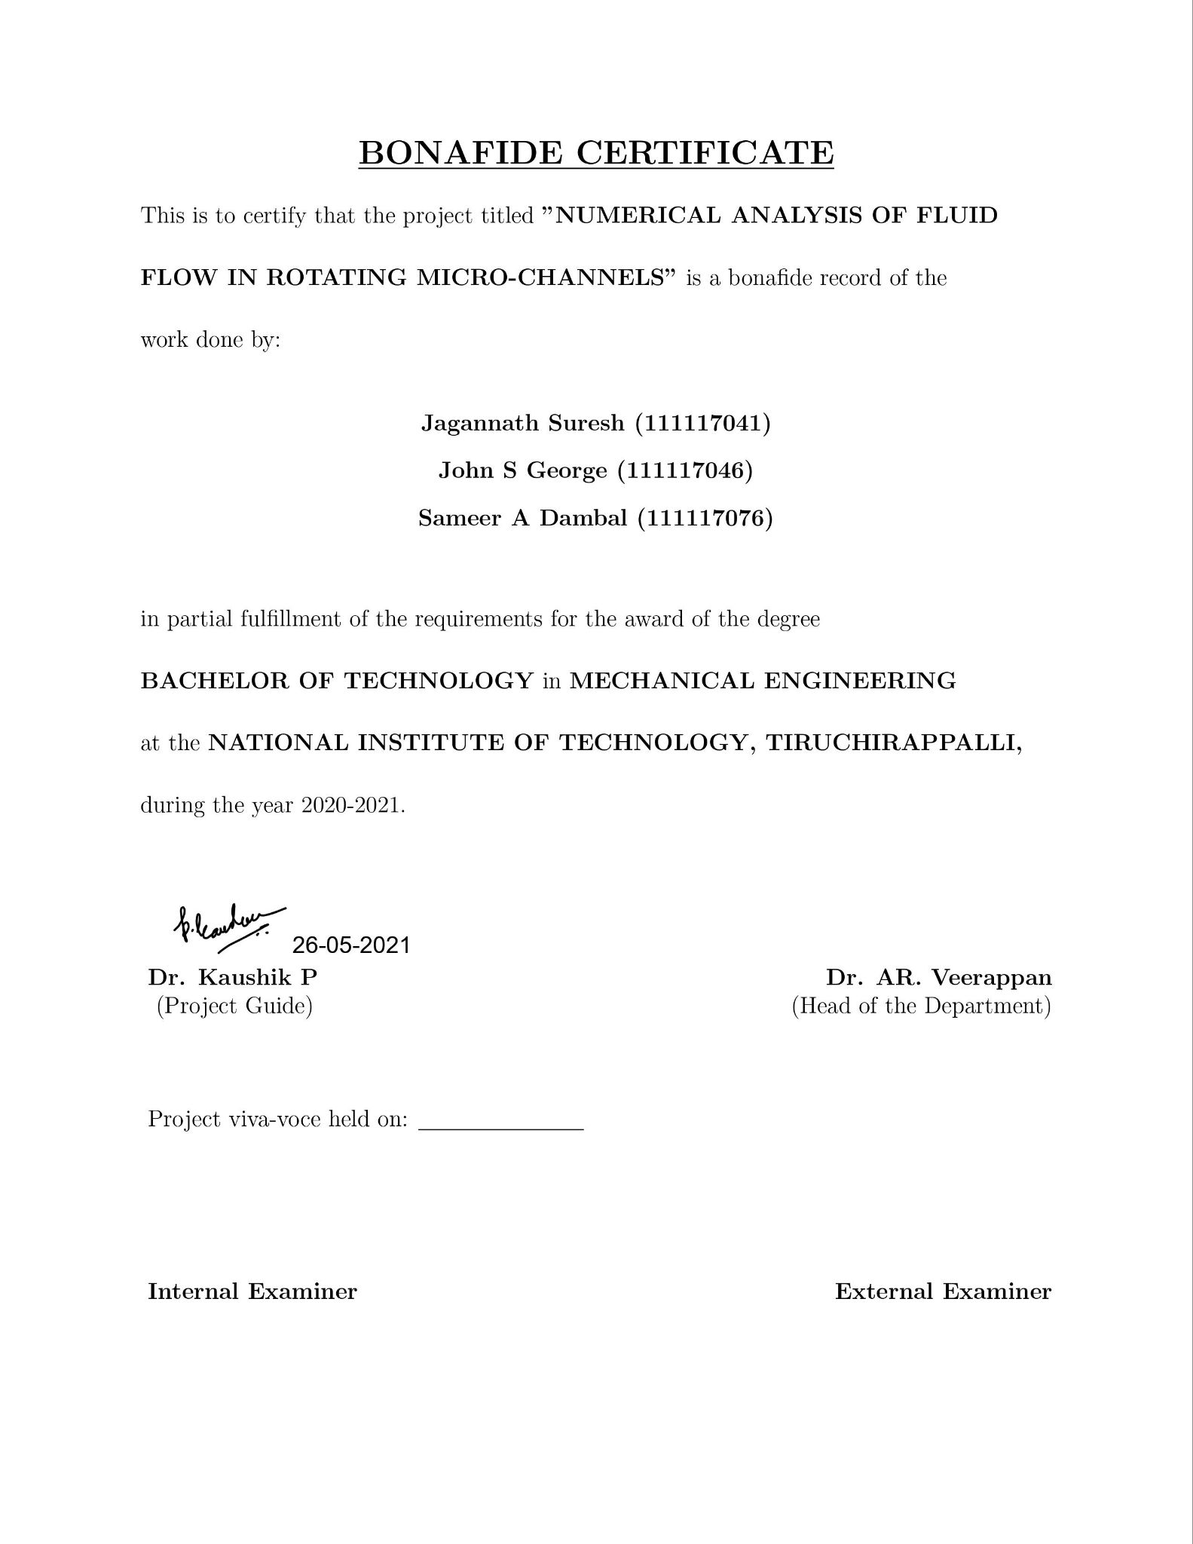

Slide 3
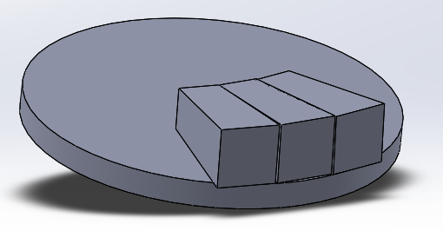
INTRODUCTION
The study of fluid flow in micro-channels has been pivotal as it finds useful application in several industries. Analysis, experimentation and research of fluid flow and mixing in rotating micro-channels is critical for centrifugally actuated microfluidic devices. They have ubiquitous applications in chemical analysis, biomedical applications and most importantly,in drug delivery. The current study models the fluid flow in similar micro-channels. However, we aim to probe the implications of rotating the micro-channel and understand how the rotation speed, Reynolds number, rotational Reynolds number and other parameters affect the potential mixing ability of the microdevice.

Slide 4
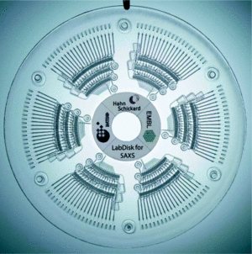
POTENTIAL APPLICATIONS
Medicine
The centrifugal microfluidic platform, including the chip and the device, has been a focus of academic and industrial research efforts for almost 40 years primarily targeting biomedical applications. Therefore, different liquid-handling platforms have been developed to implement unit operations such as sample take-up, sample preconditioning, reagent supply, metering, aliquoting, valving, routing, mixing, incubation, washing, as well as analytical or preparative separations
Lab-on-a-chip technology, also known as lab-on-a-disc, that can be used to integrate processes such as separating, mixing, reaction and detecting molecules of nano-size in a single piece of platform, including a compact disk or DVD. This type of micro-fluidic biochip is based upon the principle of microfluidics; to take advantage of noninertial pumping for lab-on-a-chip devices using noninertial valves and switches under centrifugal force and Coriolis effect to distribute fluids about the disks in a highly parallel order.

Slide 5
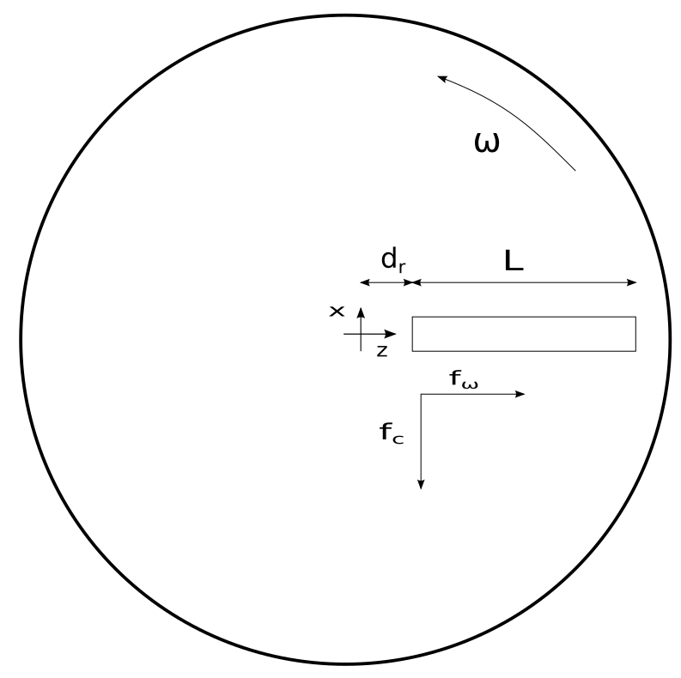
MATHEMATICAL MODELLING
Centrifugal and Coriolis forces are the additional forces acting due to rotation.
The disk is rotated in the anti-clockwise direction about the Y axis.
Hence, the effect of the forces due to rotation are present in the X and Z directions.

Slide 6
GOVERNING EQUATIONS AND BOUNDARY CONDITIONS
GOVERNING EQUATIONS
The flow was assumed to be steady, laminar and incompressible.
Since the primary objective of the numerical study is to understand the development of the velocity and pressure fields in the rotating micro-channel, the governing equations for the study are the equations of continuity and momentum conservation for a three dimensional steady, laminar and incompressible flow.

Slide 7
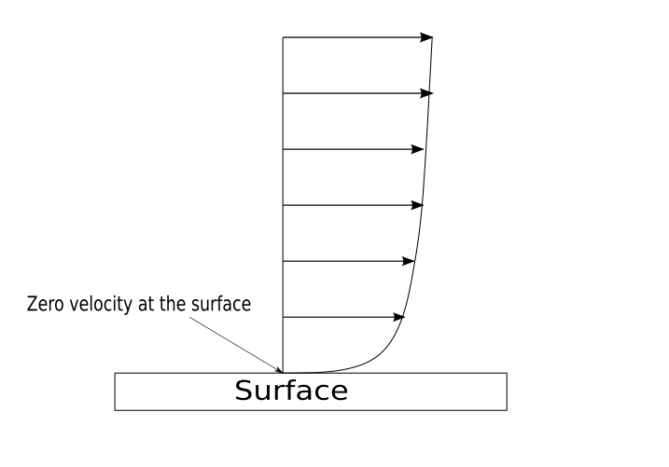
CONTD..
BOUNDARY CONDITIONS
No Slip boundary condition at the wall
Specified velocity at the inlet
Specified pressure at the outlet
Later on in the study, the specified pressure boundary condition at the outlet was altered pertaining to a few irregularities.

Slide 8
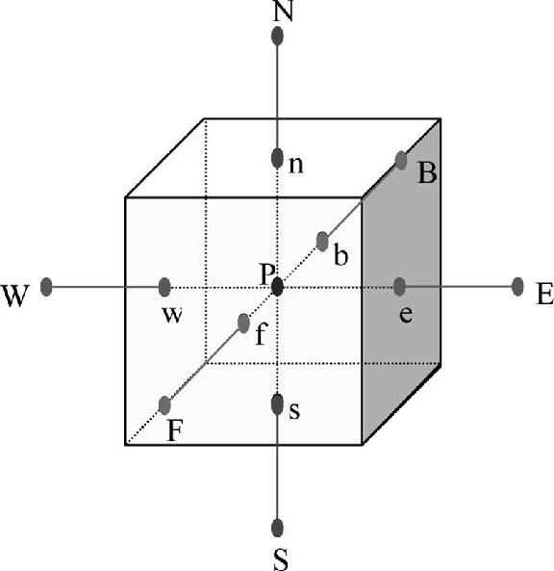
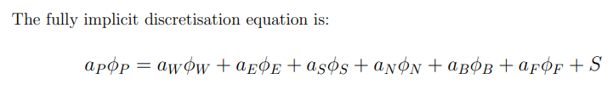
NUMERICAL SOLUTION
A finite volume technique was used to discretise the governing equations.
Collocated grid was chosen for the ease of book-keeping and coding.
Hybrid differencing scheme was chosen over the central and upwind differencing schemes to discretise the 3D convection-diffusion equation.

Slide 9

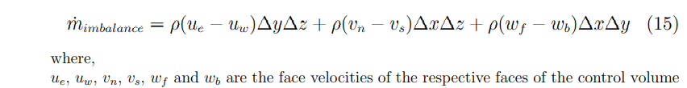
CONTD..
SIMPLE algorithm was used to solve the discretized governing equations.

Slide 10
CONTD..
Rhie- Chow interpolation scheme was used to calculate the face velocities and in turn the mass imbalance in the pressure correction equation.
Optimum under relaxation factors were used to correct the velocities are pressure to account for the approximation made in the SIMPLE algorithm.
Tried multiple solvers like Gauss Seidel, Stone’s SIP method and Conjugate Gradient method to solve for the iterative equations for pressure correction and momentum and concluded to go with Conjugate gradient method due to faster convergence

Slide 11
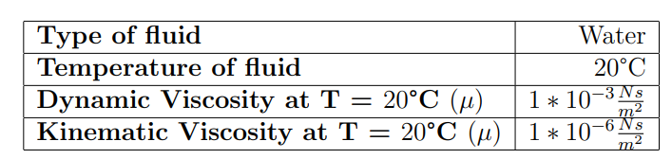
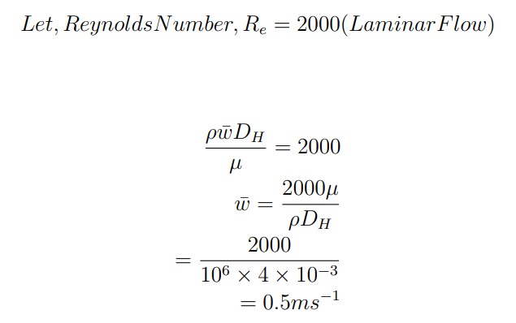
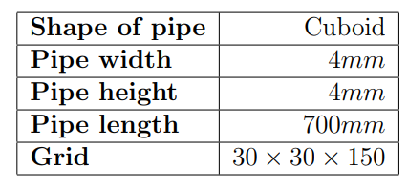
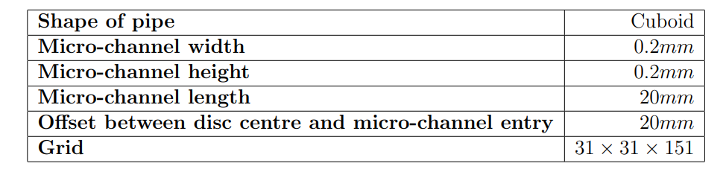
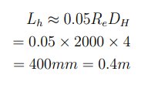
RESULTS

Slide 12
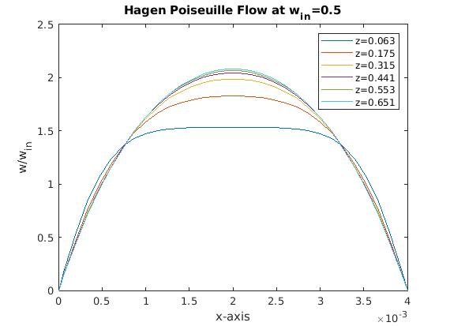
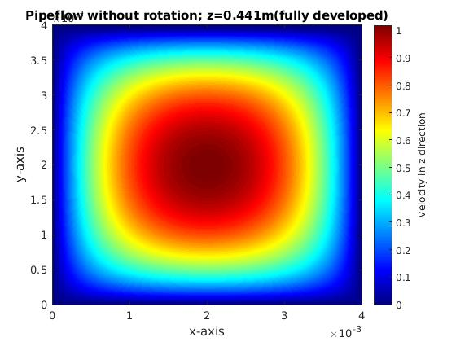
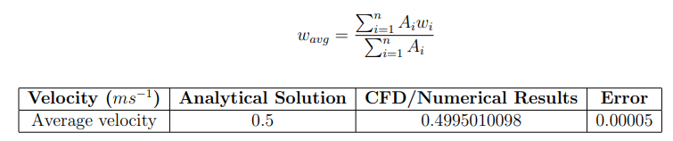
Axial velocity profile showing development of hydrodynamic layer

Slide 13
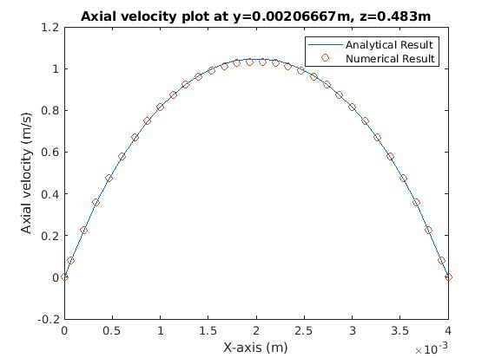
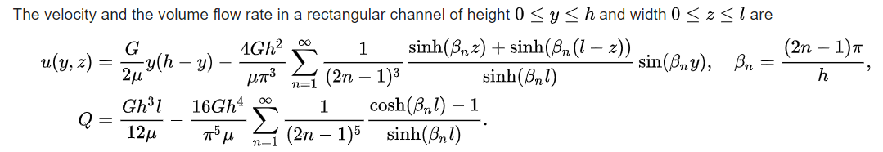
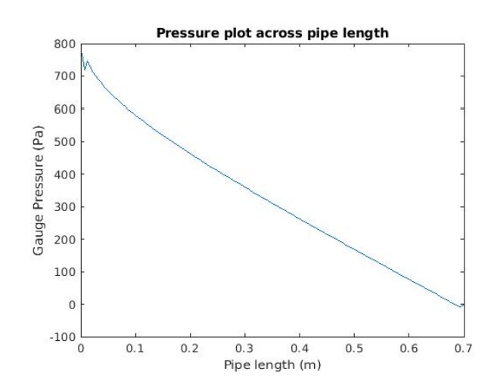
G: -dp/dx, constant pressure gradient in developed region
G(analytical) = 889.192 Pa/m
G(numerical) = 849.882 Pa/m
Error = 4.42%

Slide 14
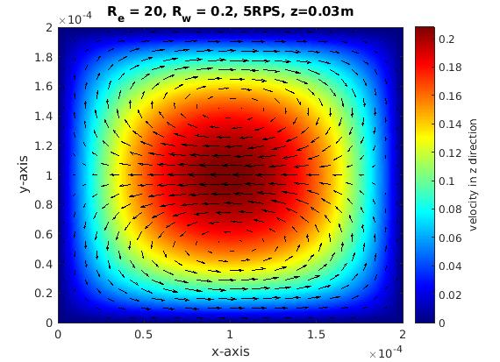
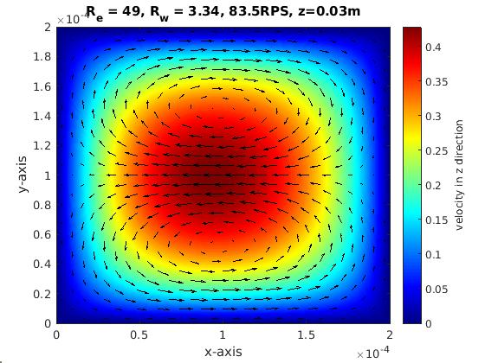
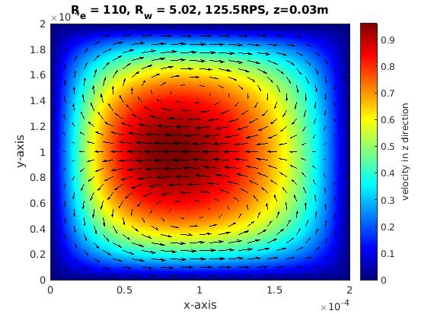
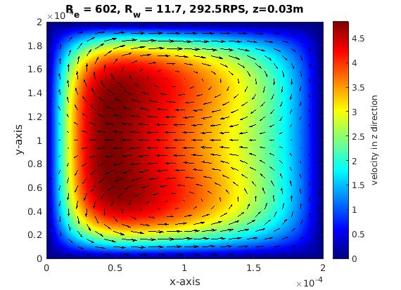
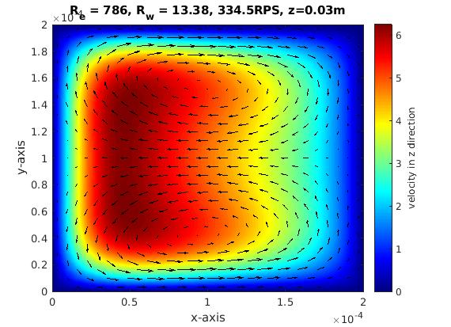
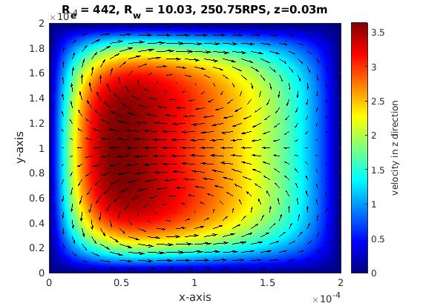
Flow through a rotating microchannel

Slide 15
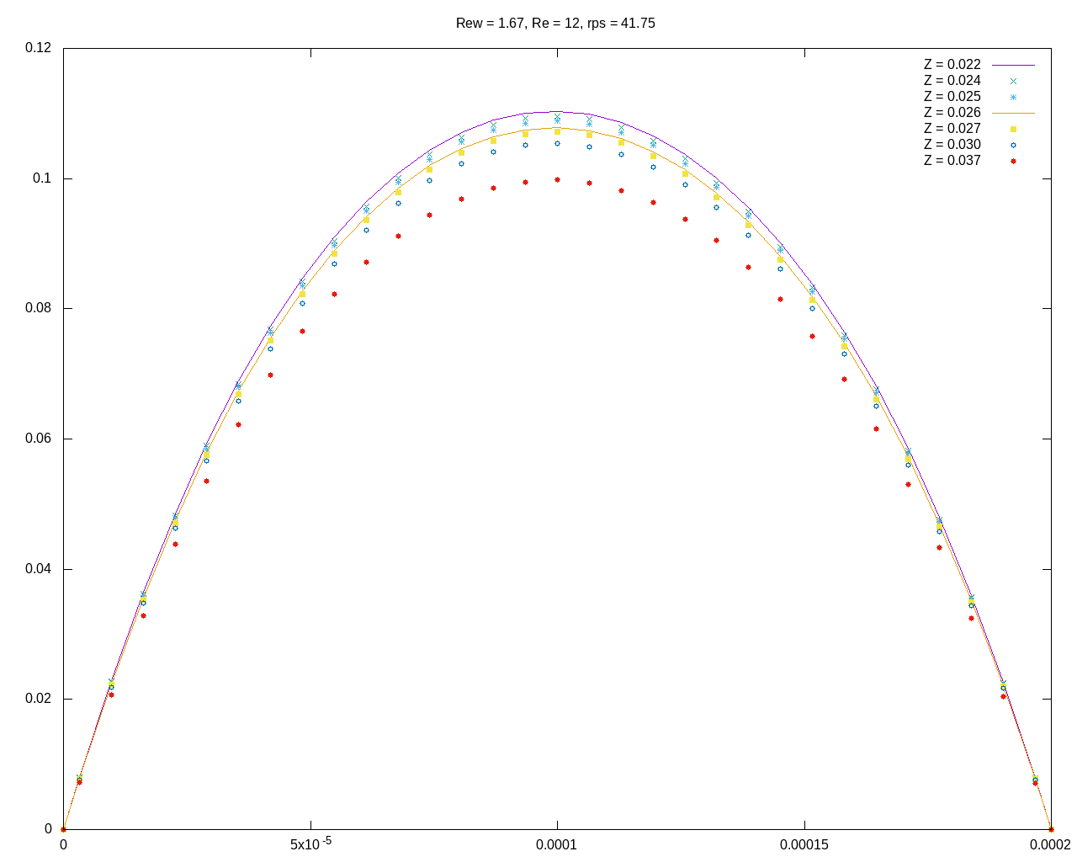
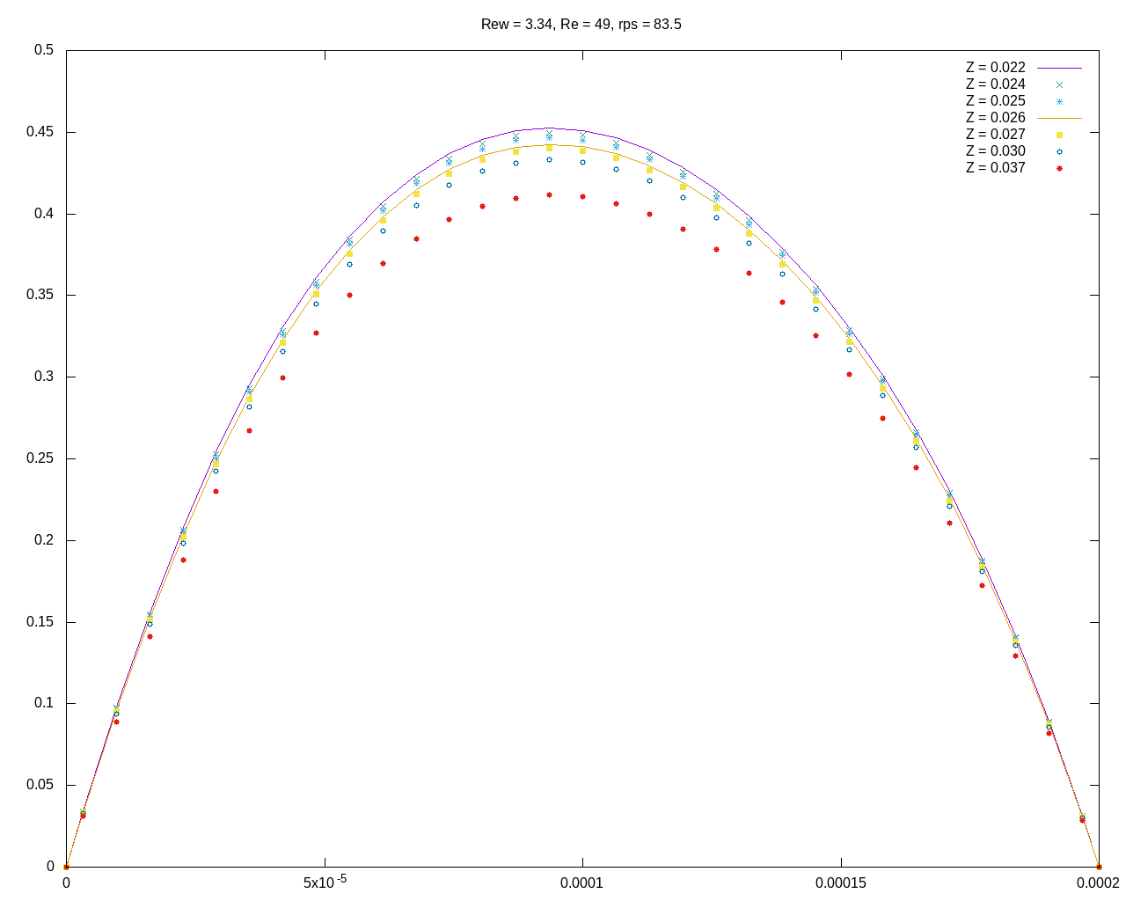
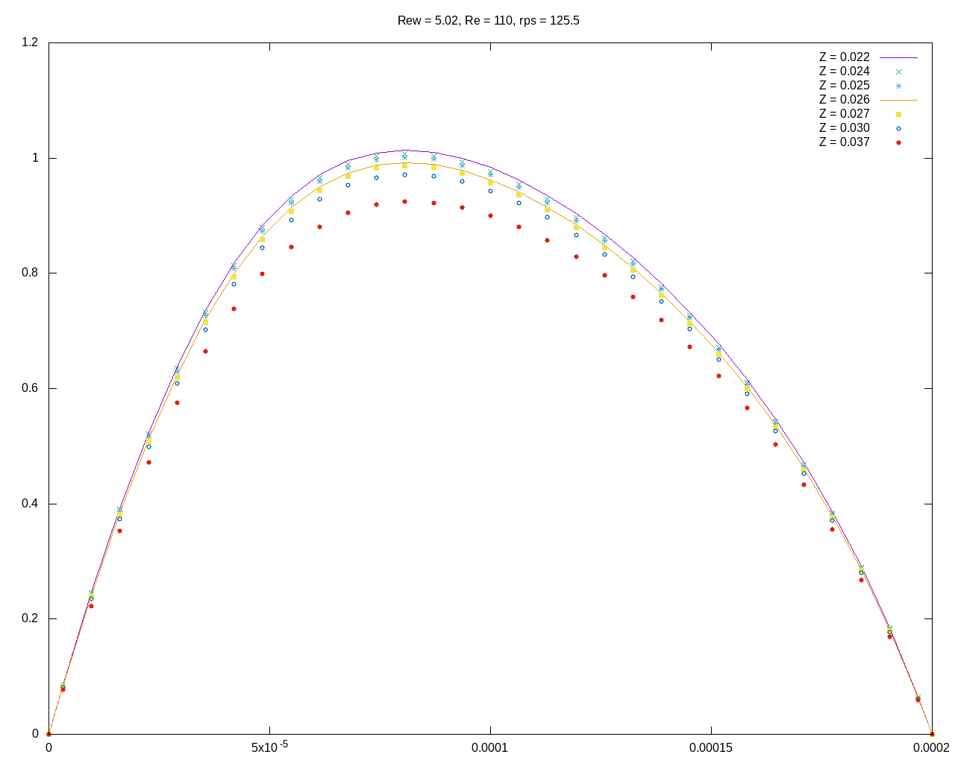
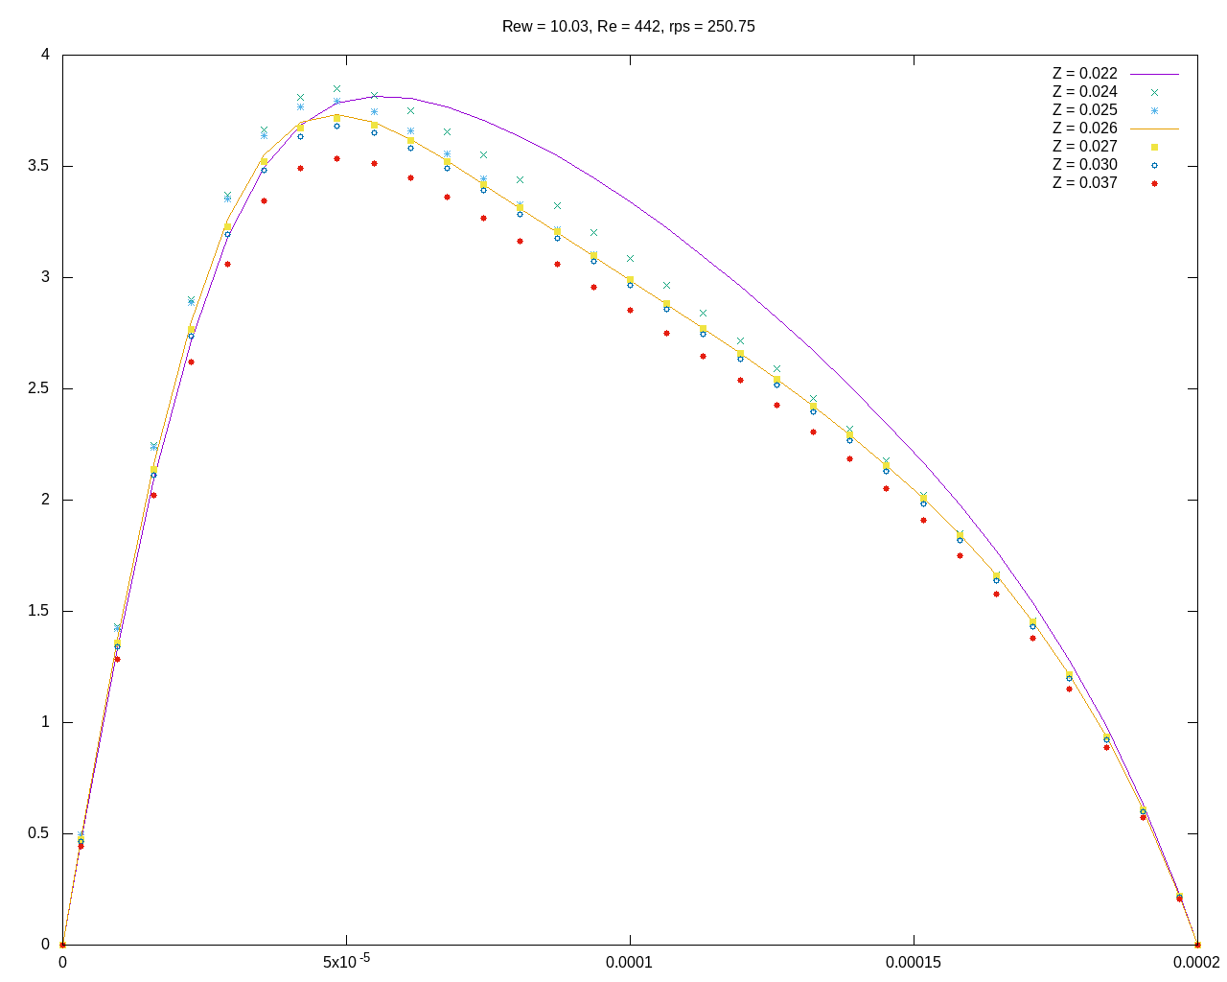
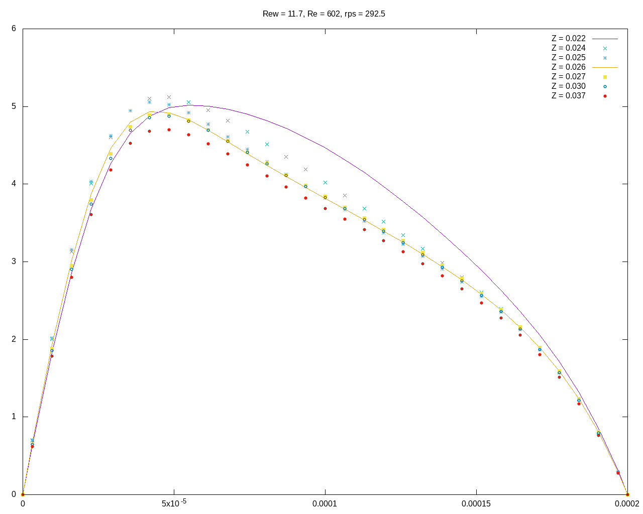
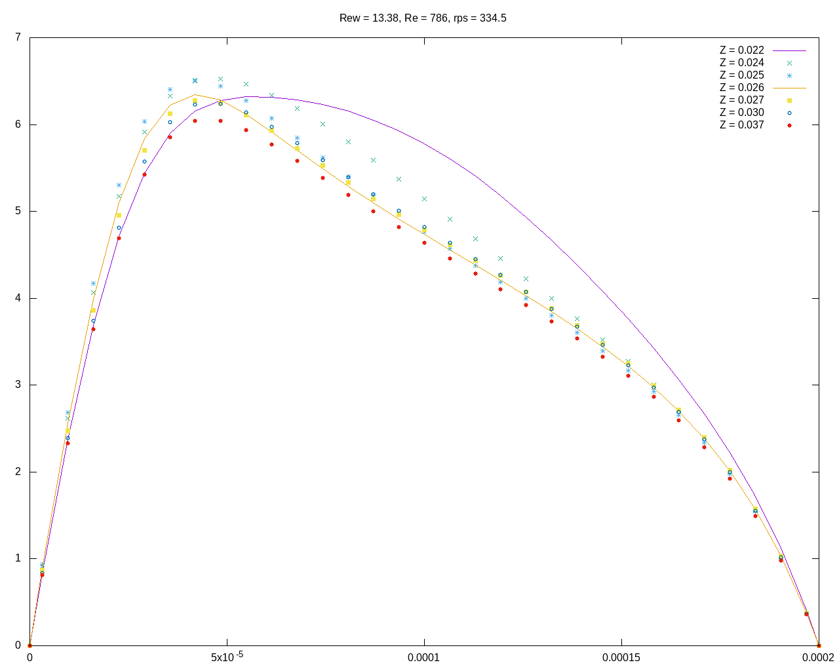
Microchannel flow with varying Re, Rew, RPS

Slide 16

FUTURE WORK
Refine mesh at the boundaries
Implement mass conservation based pressure correction at the outlet half-control volume.
Conduct Regression Analysis based on the Buckhingham Pi Theorem functional relation shown below
Later on, mixing in micro-channel will be investigated

Slide 17
REFERENCES
A review of flow and heat transfer in rotating microchannels, Pratanu Roy, N.K. Anand, Debjyoti Banerjee.
Numerical simulation of flow and heat transfer in radially rotating microchannels, Pratanu Roy, N.K. Anand, Debjyoti Banerjee.
Comparison between staggered and collocated grids in the finite-volume method performance for single and multi-phase flows, H.F. Meier, J.J.N. Alves, M. Mori
Generalized formulations for the Rhie–Chow interpolation, Sijun Zhang , Xiang Zhao , Sami Bayyuk
A Calculation Procedure for heat, mass and momentum transfer in three-dimensional parabolic flows, S. V. Patankar and D. B. Spalding
An introduction to computational fluid dynamics, H K Versteeg and W Malalasekera
Numerical Heat transfer and fluid flow, Suhas Patankar
Solution of navier-stokes equations on non-staggered grid, A.W. Date
Implementation of boundary conditions in the finite-volume pressure-based method—part i: Segregated solvers, Fadl Moukalled, Luca Mangani, and Marwan Darwish.
Computational methods for fluid dynamics, Joel H Ferziger, Milovan Peri´c, and Robert L Street

